Slide 1
자바기본프로그래밍 2강
Kopo30 이동현

Slide 2
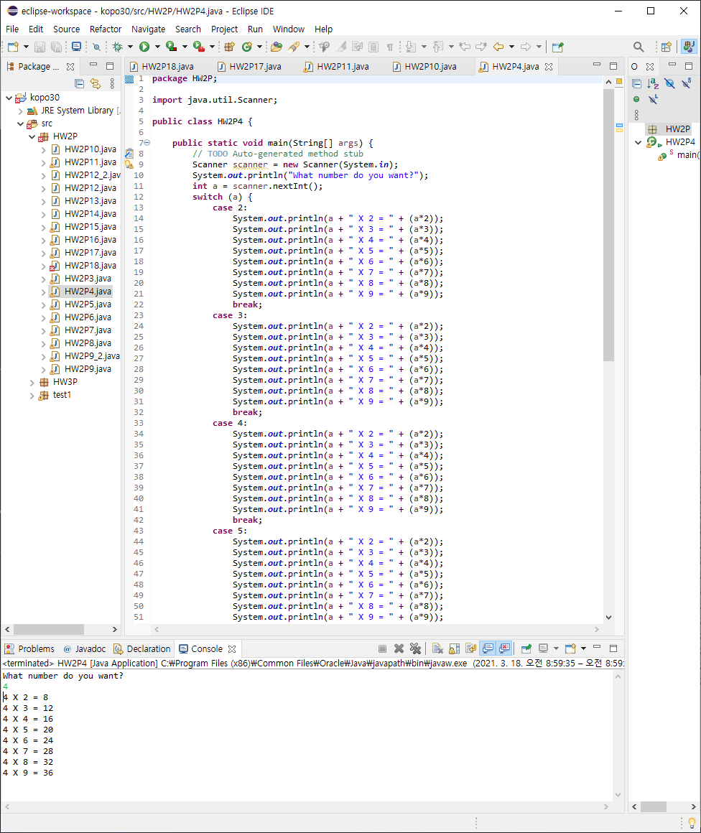
2-P4 : Multiplication Table

Slide 3
Q1* : Why aren’t they equal to each other?
String text는 hello?이지만, If 문 안에 들어있는 조건은 hello일때만 It’s hello라고 출력하라고 되어있다.
이 조건이 포함되려면 text.equals(“hello”)를 text.contains(“hello”)로 바꾸면 String text의 hello? 안에 hello가 포함되어서 It’s hello가 출력된다.

Slide 4
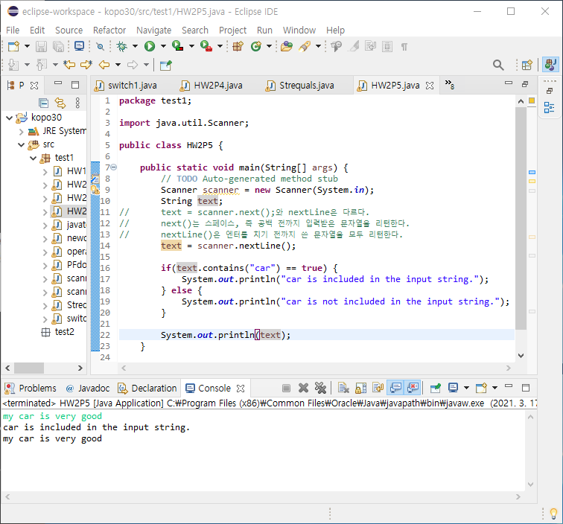
2-P5 : Word Containing Program

Slide 5
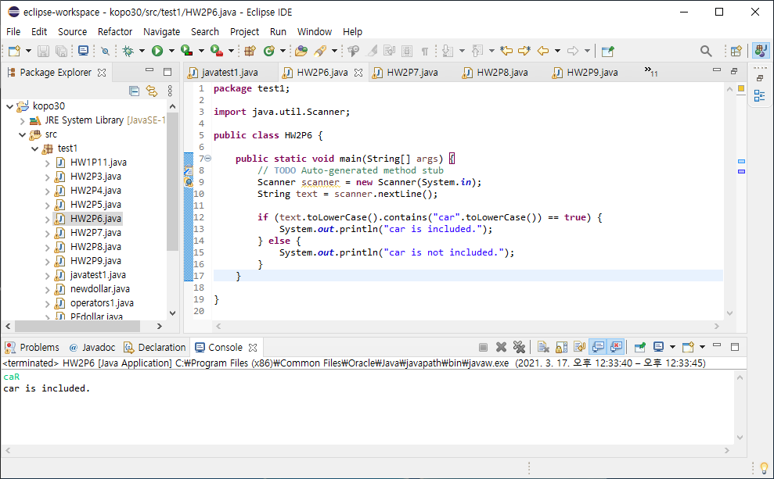
2-P6 : Word Containing Program 2

Slide 6
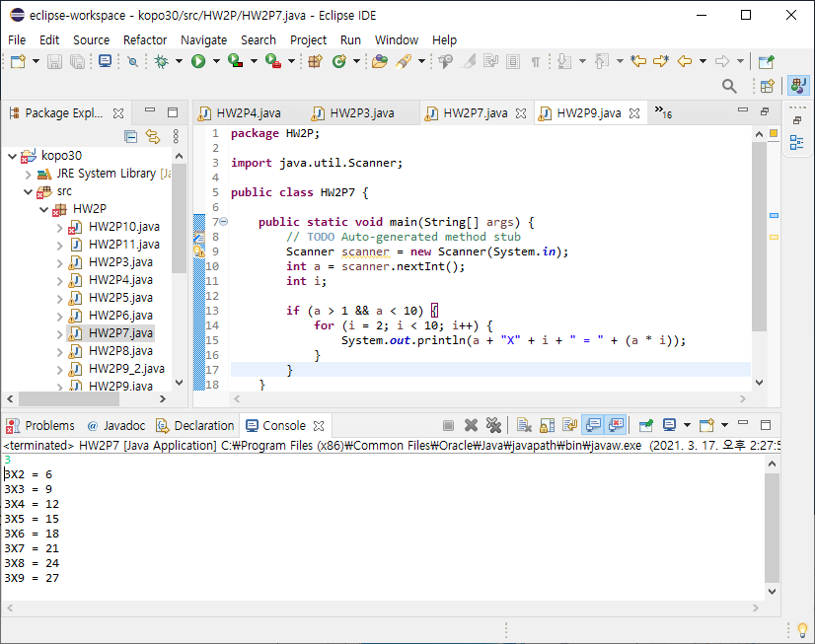
2-P7 : Multiplication Table 2

Slide 7
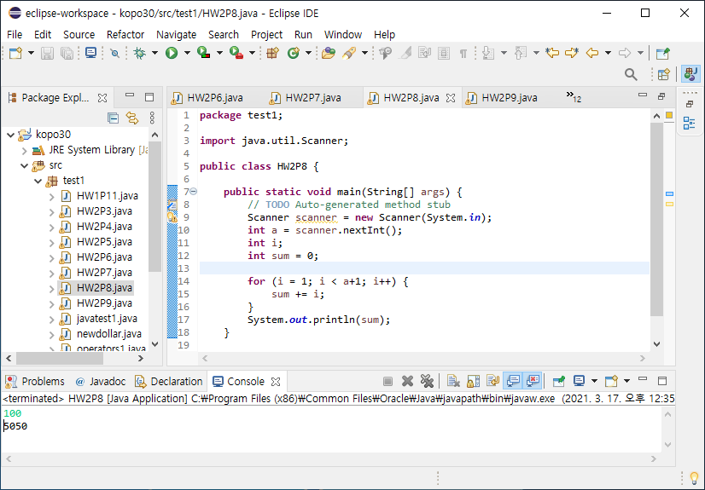
2-P8 : Arithmetic Progression

Slide 8
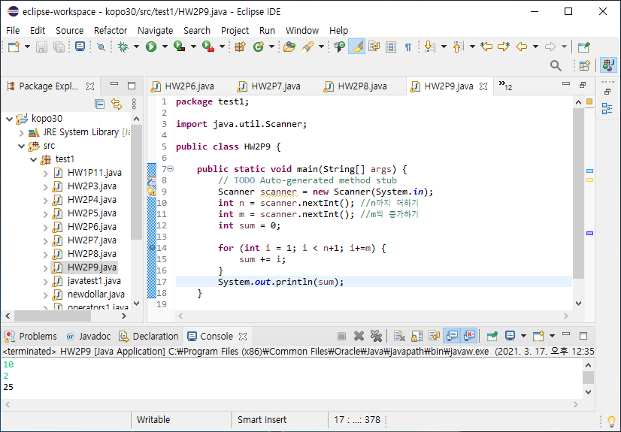
2-P9-1 : Arithmetic Progression 2

Slide 9
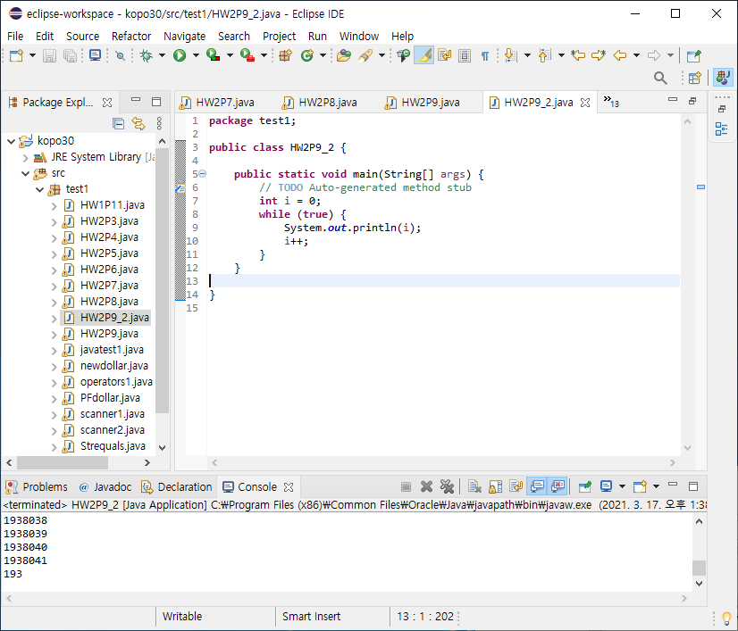
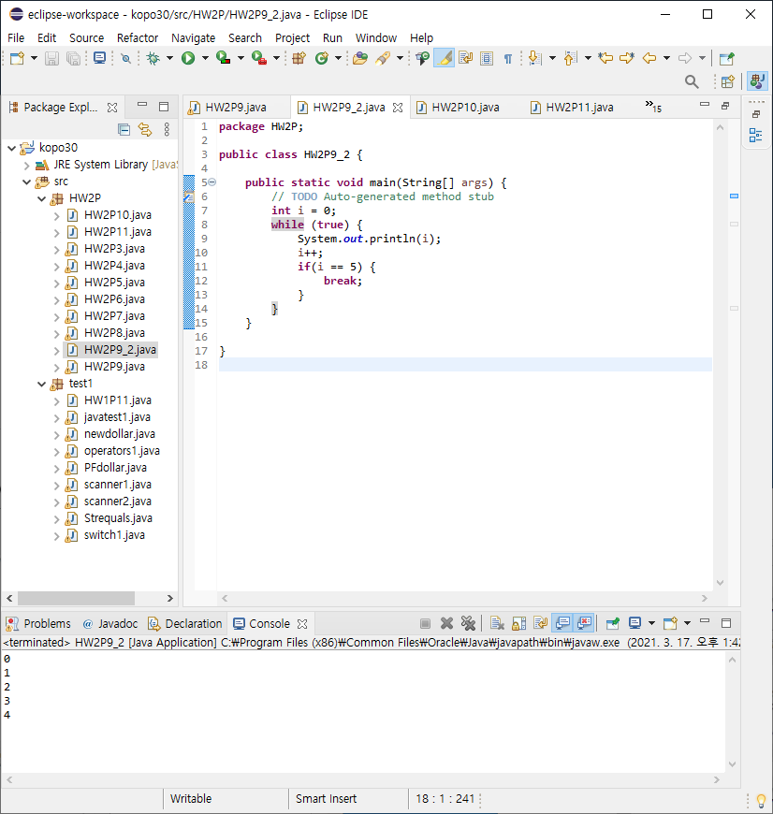
2-P9-2 : Check the result with “while(true)” statement

Slide 10
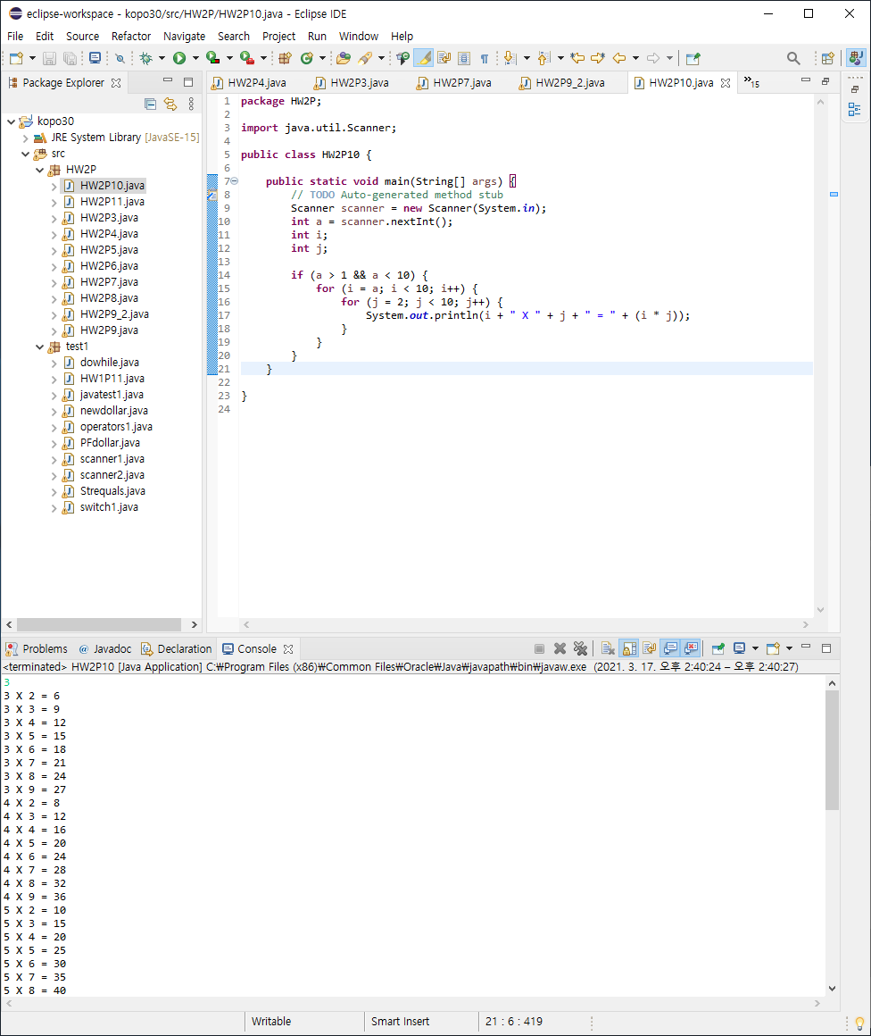
2-P10 : Multiplication Table 3

Slide 11
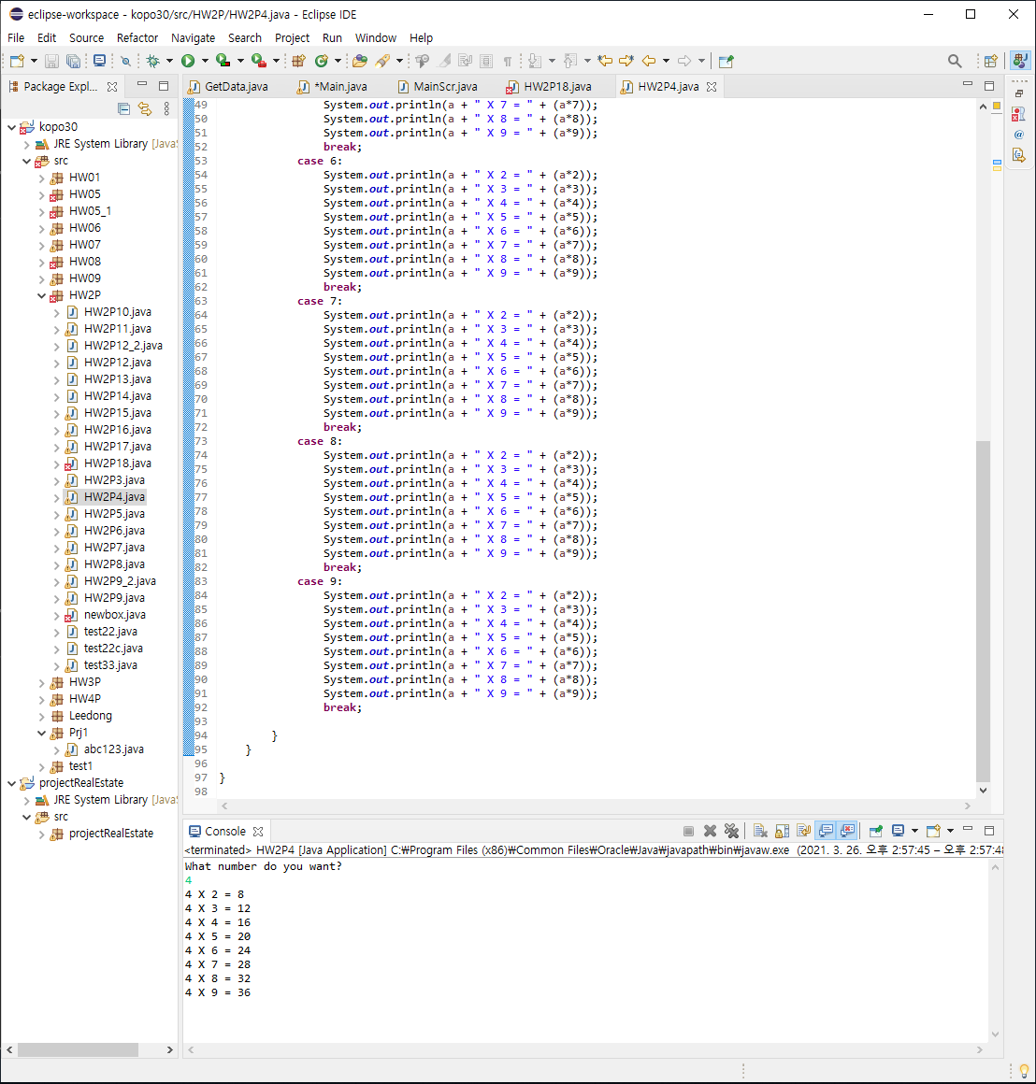
2-P11 : Multiplication Table 4

Slide 12
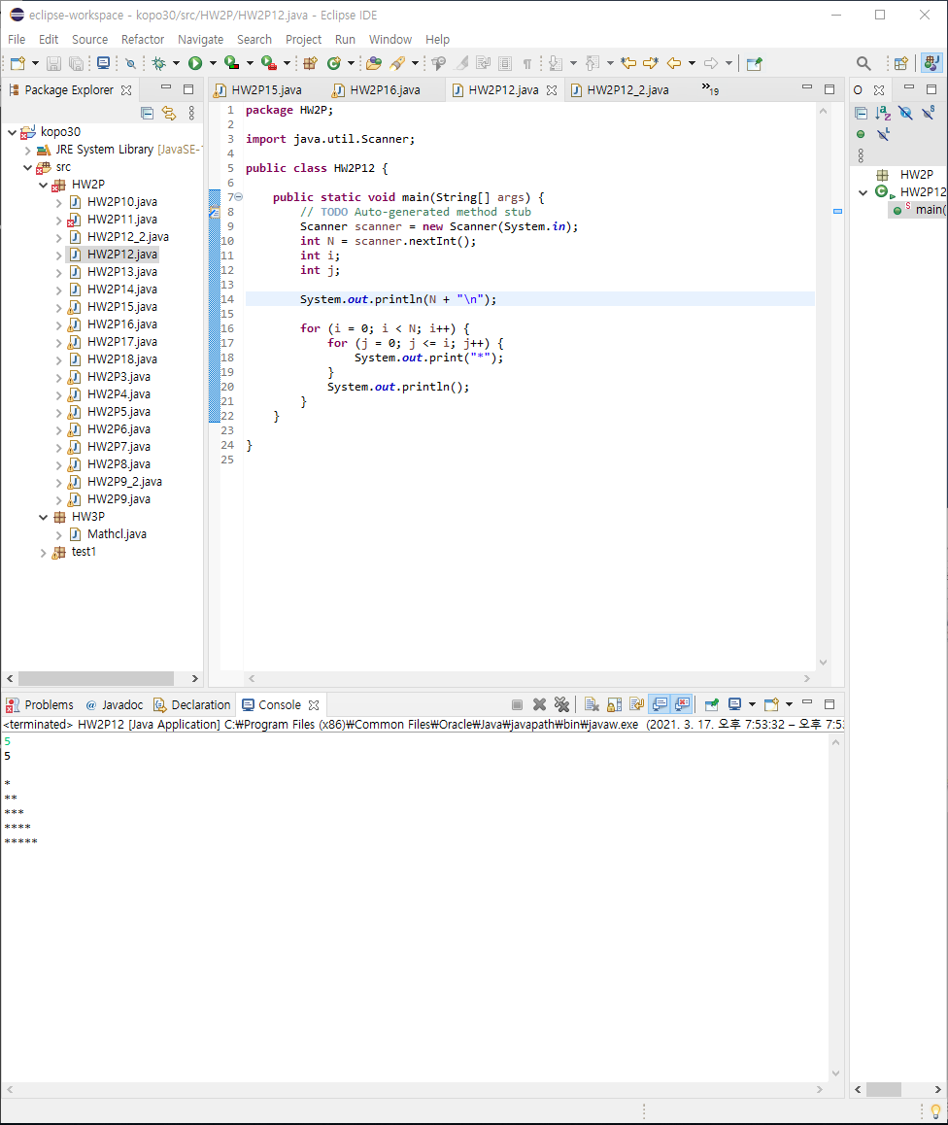
2-P12 : Draw a Right Triangle

Slide 13
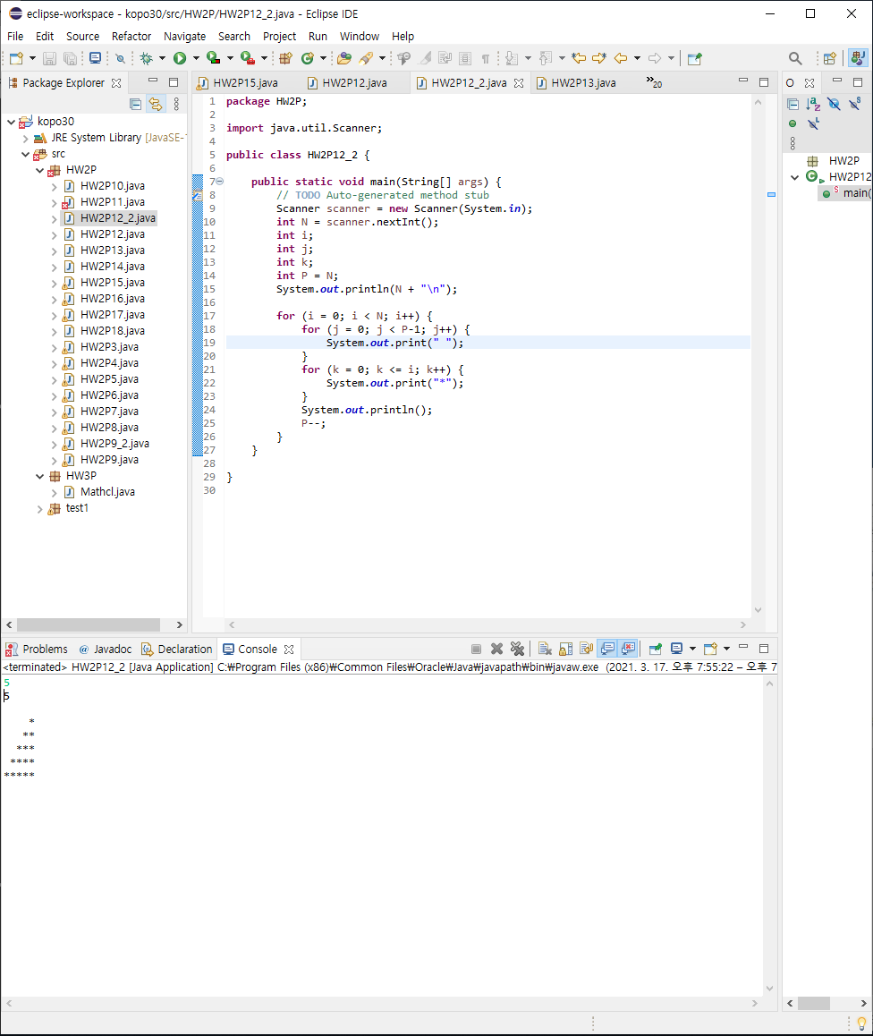
2-P12_2 : Draw a Left Triangle

Slide 14
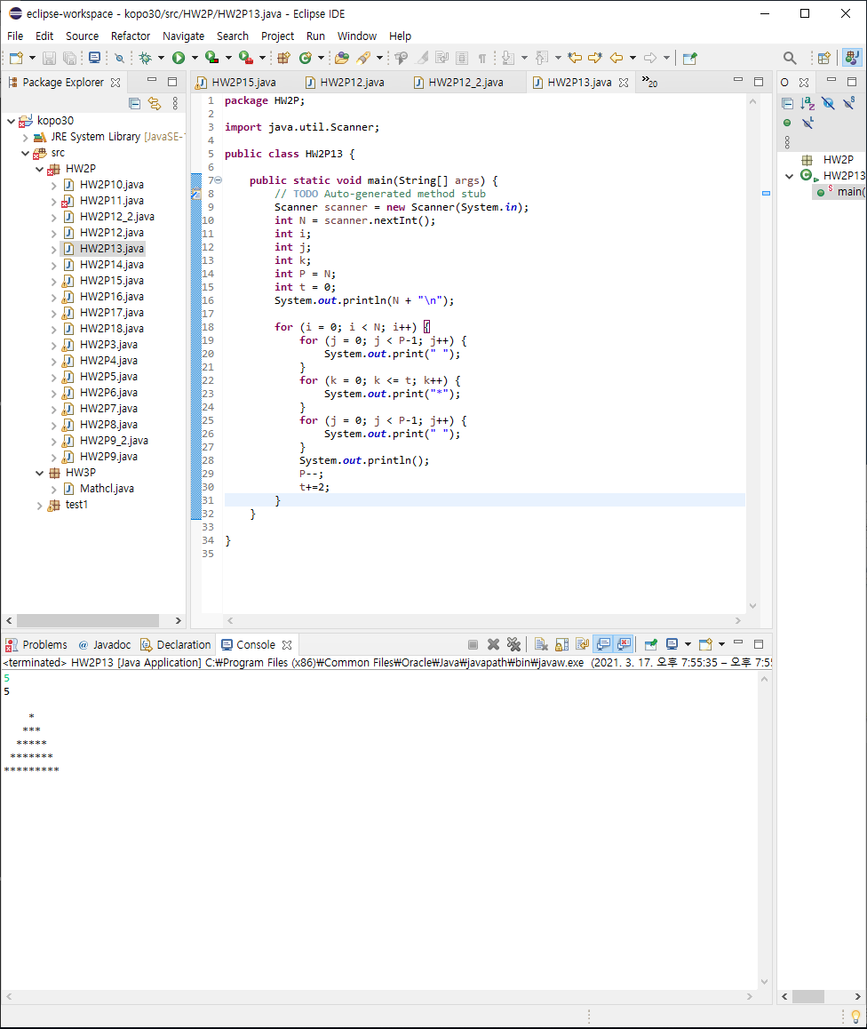
2-P13 : Draw an Equilateral Triangle

Slide 15
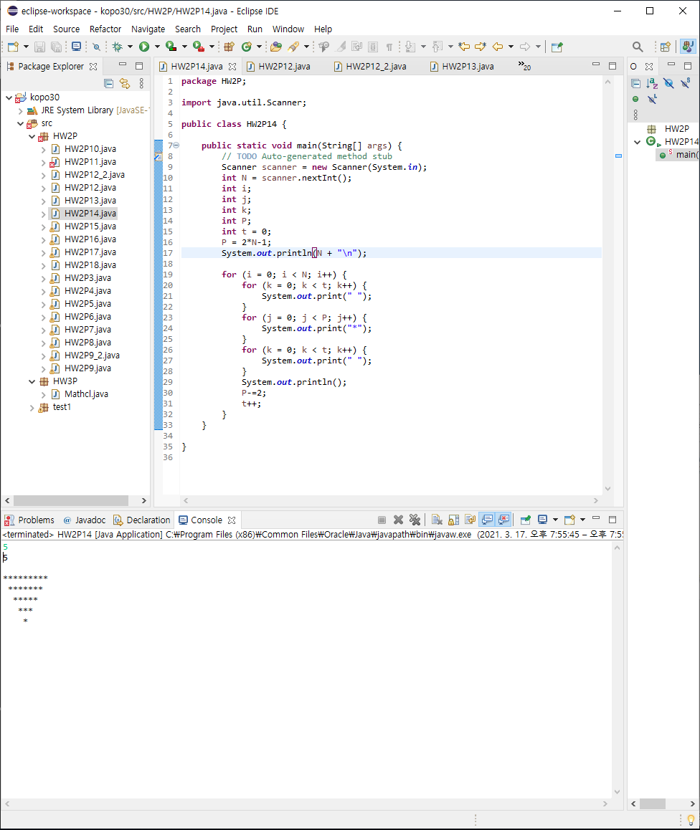
2-P14 : Draw an Inverted Equilateral Triangle

Slide 16
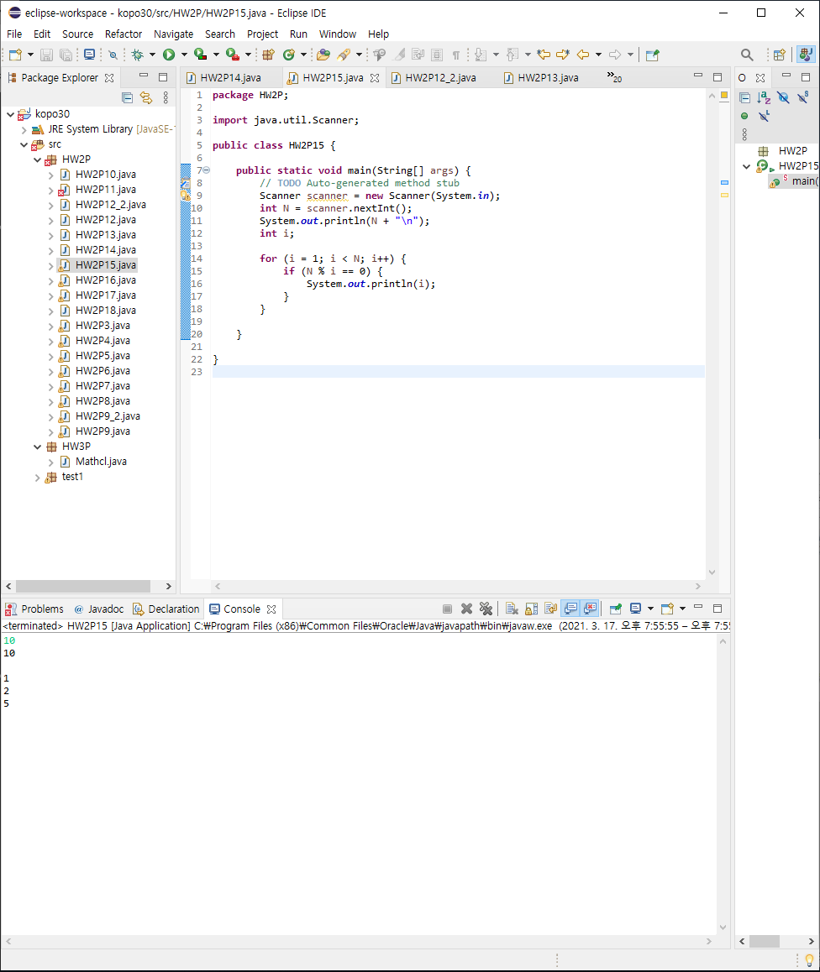
2-P15 : Find the Factors of N

Slide 17
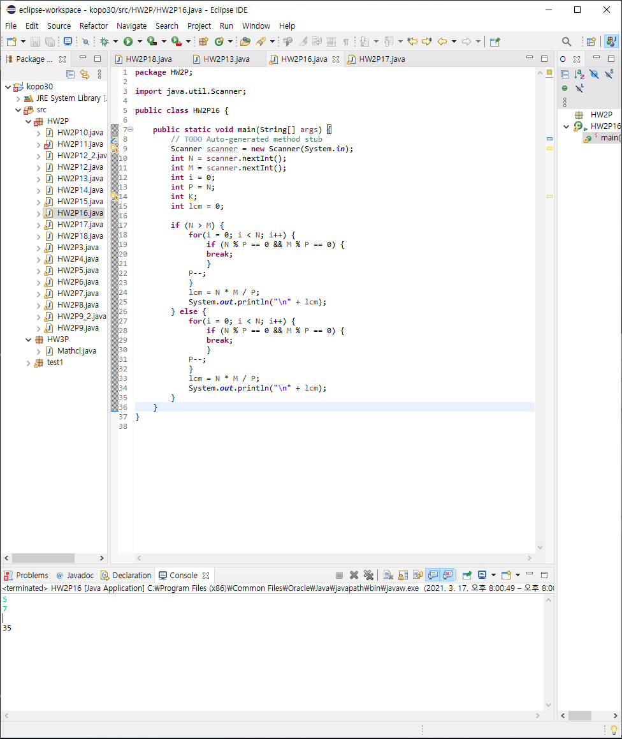
2-P16 : Find the LCM(Least Common Multiple)

Slide 18
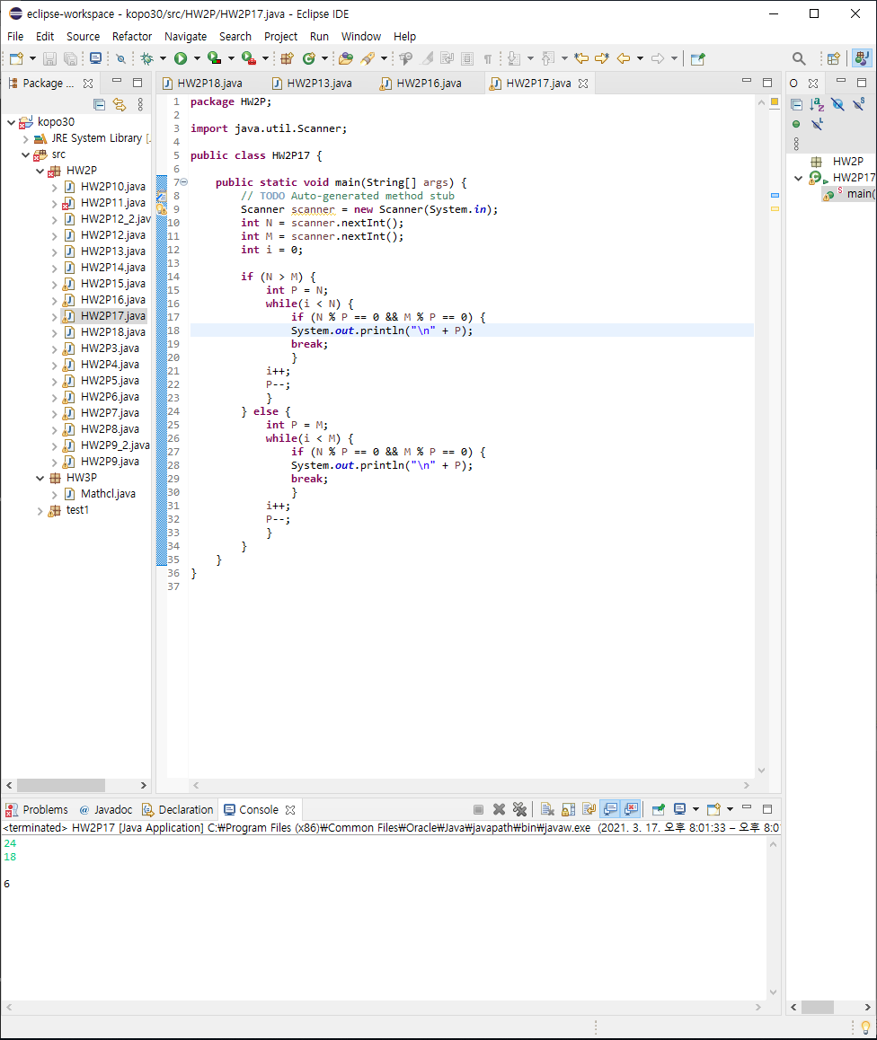
2-P17 : Find the GCD(Greatest Common Divisor)

Slide 19
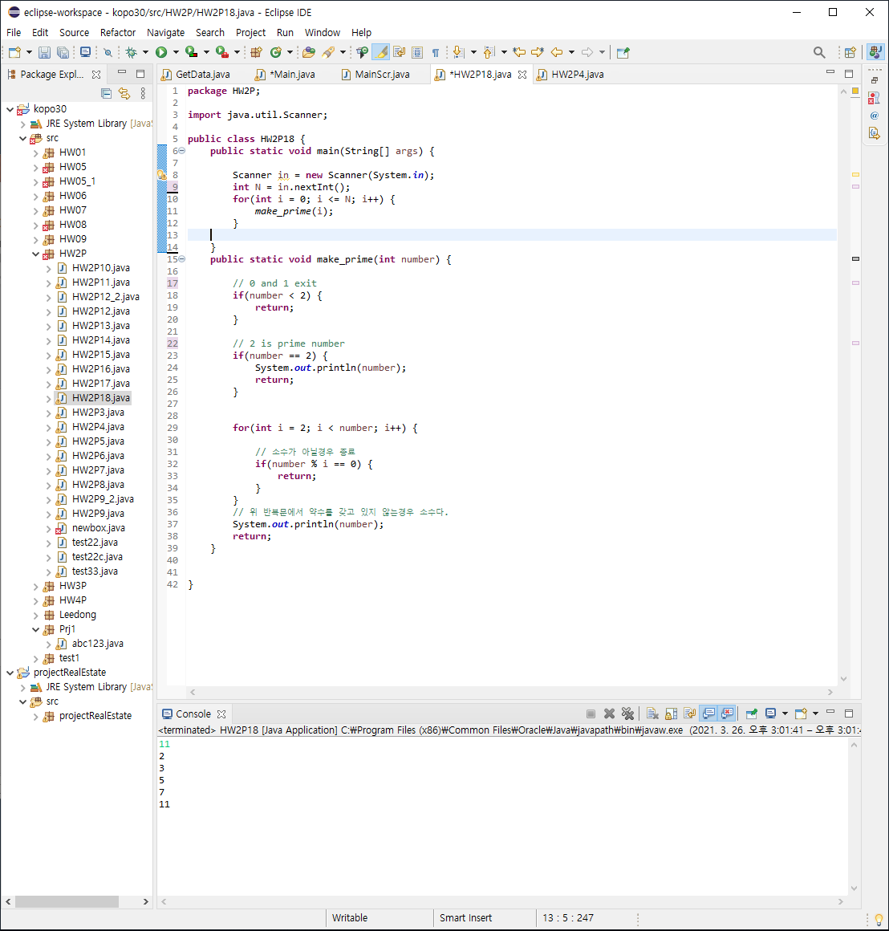
2-P18 : Find the Prime Numbers

